Slide 1
What sensor patterns precede gearbox events, and how early can we flag them?

Slide 2
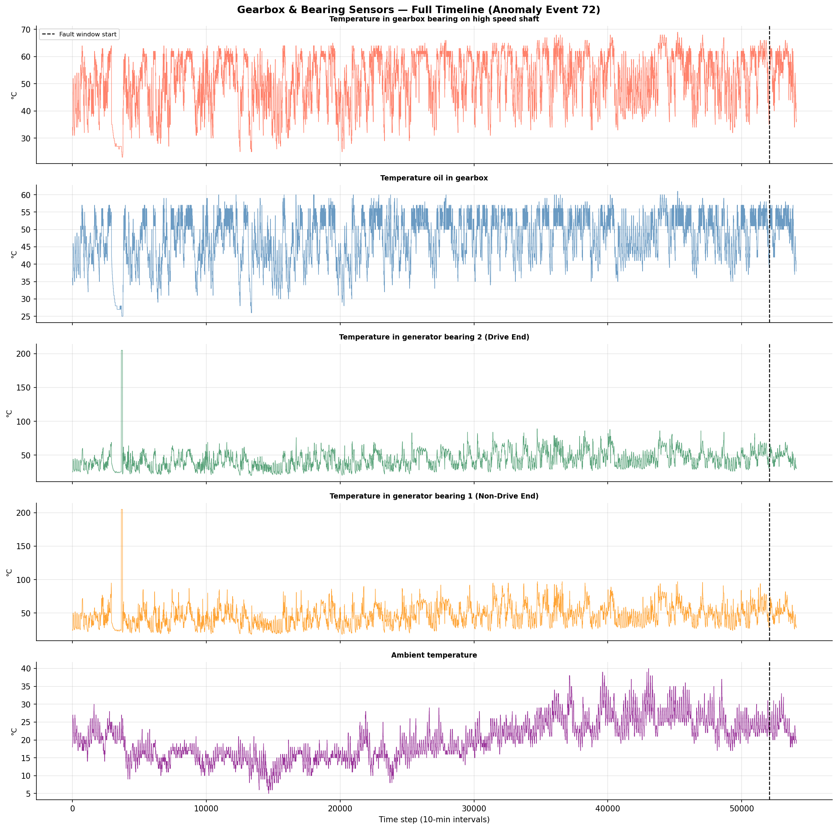
We started by loading a full year of sensor data from Turbine 21, which experienced a confirmed gearbox failure. This chart shows 5 sensors simultaneously — gearbox bearing temperature, gearbox oil temperature, both generator bearing temperatures, and ambient temperature. The dashed vertical line is when the fault was officially logged. Two things jumped out immediately: the generator bearing sensors show a massive spike early in the dataset, suggesting prior mechanical stress, and the ambient temperature follows a clear seasonal pattern confirming this is real, unprocessed field data.
Notes:
"This chart shows 5 different temperature sensors inside a wind turbine over roughly one year of operation, recorded every 10 minutes. The dashed vertical line marks when the gearbox officially failed. Two things stand out: the generator bearing sensors (green and orange) show a massive spike early on — reaching over 200°C — which likely indicates a separate earlier stress event. The ambient temperature at the bottom follows a natural seasonal pattern, rising in summer and falling in winter, which confirms the data is real-world and unaltered. This overview gives us the full picture before we zoom in."

Slide 3
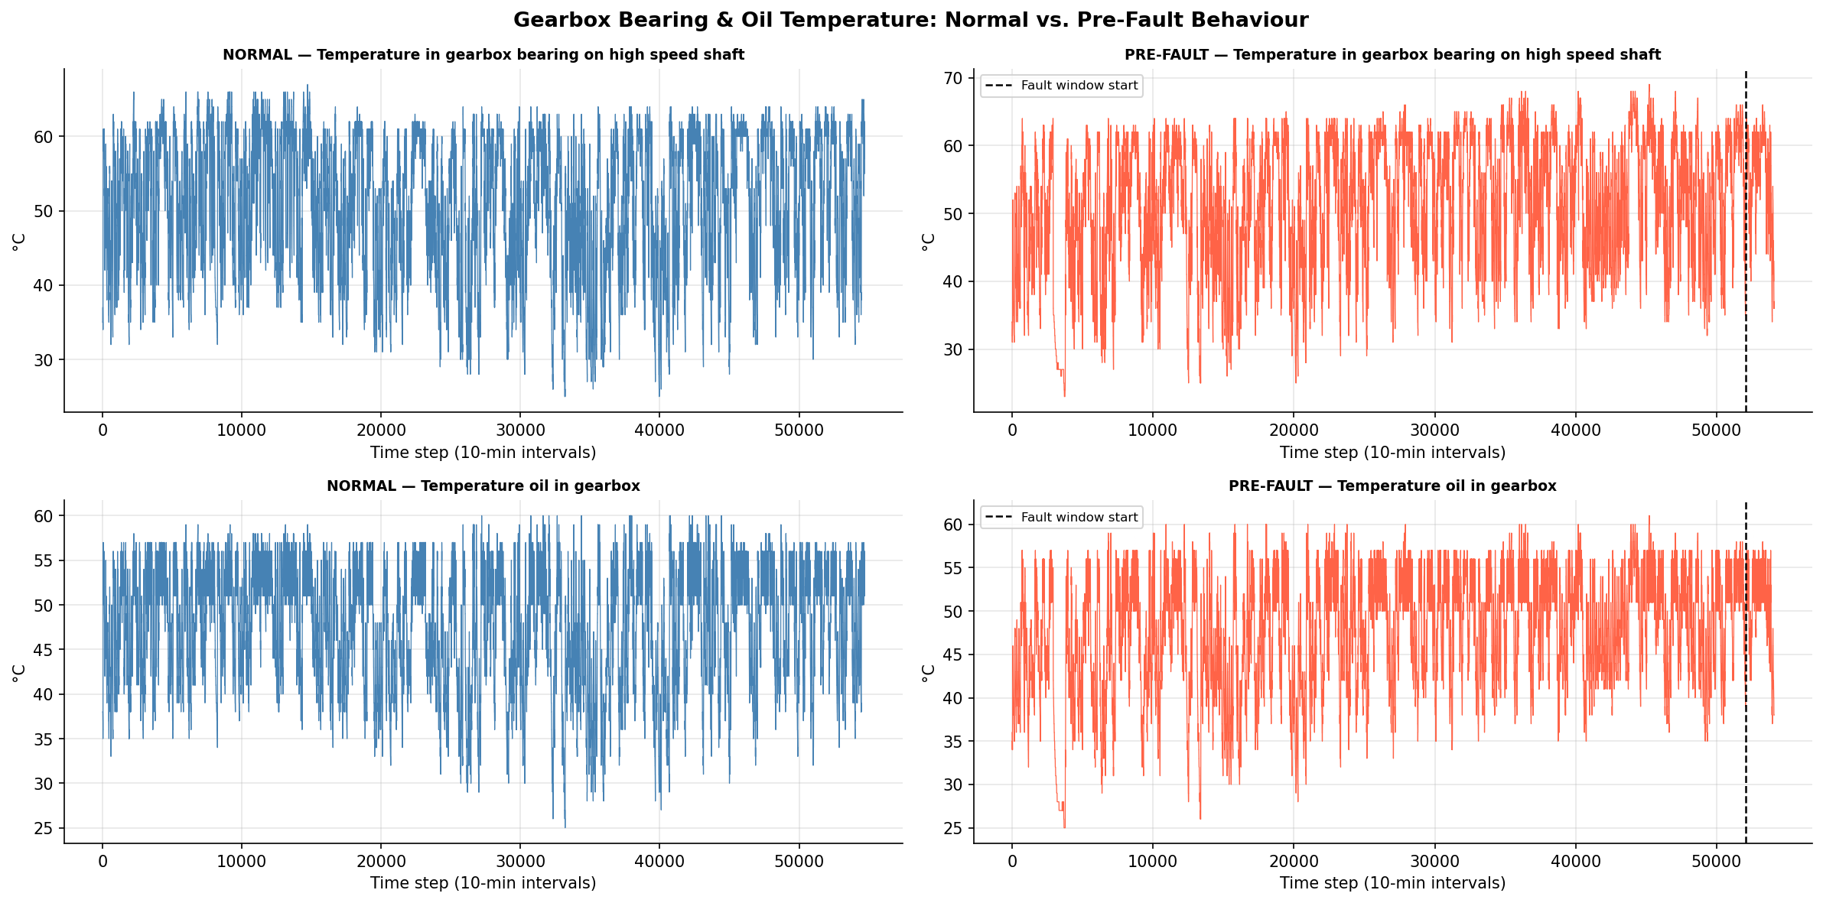
We then compared the same sensors from a healthy turbine on the left against our failing turbine on the right. At first glance they look similar — but look carefully at the pre-fault charts. The temperatures dip much lower and more frequently, reaching 25°C at times. These sharp drops indicate the turbine was repeatedly shutting itself down in the months before failure — a classic sign of a system under stress. A healthy turbine doesn't behave like that.
Notes:
"Here we compare a healthy turbine (blue, left column) against the turbine that later failed (red, right column). The gearbox bearing temperature on top and the gearbox oil temperature on the bottom both look visually similar at first glance — but look at the red charts: they dip much lower at times, reaching 25°C, which indicates the turbine was shutting down repeatedly in the months before failure. A healthy turbine doesn't do that nearly as often. These unexpected shutdowns are an early warning sign that something was wrong long before the official fault was logged."

Slide 4
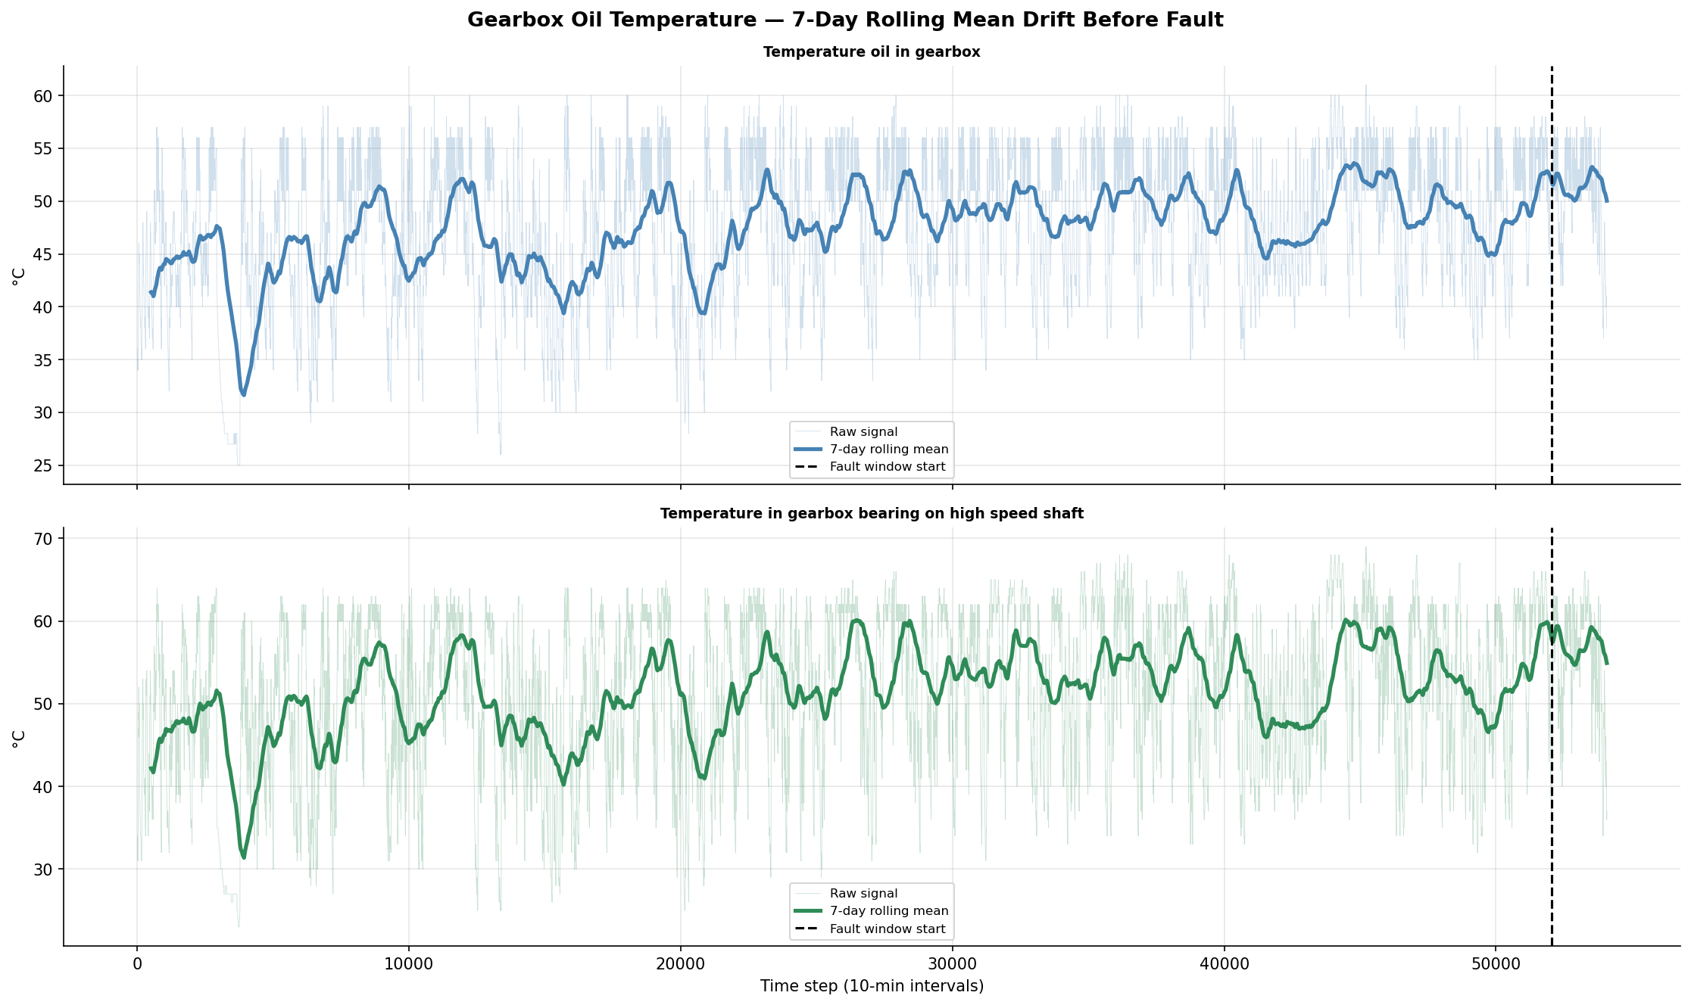
Raw sensor data is extremely noisy, it spikes every few hours with normal operating cycles. To reveal the underlying trend we applied a 7-day rolling mean, which smooths out daily fluctuations and shows the slow thermal drift over time. You can see the gearbox oil temperature gradually creeping upward in the weeks before the fault. This is the thermal fingerprint of a gearbox under increasing mechanical stress — invisible in raw data but unmistakable once smoothed.
Notes:
"Raw sensor data is extremely noisy — it spikes up and down every few hours with normal operation cycles. To see the underlying trend, we apply a 7-day rolling average, which smooths out daily fluctuations and reveals the slow drift over time. You can see in the top panel (gearbox oil) that the rolling mean gradually creeps upward in the weeks before the fault window. This is the thermal signature of a gearbox under increasing mechanical stress — like how a car engine runs hotter when something is wrong. This slow drift is invisible in raw data but clear once smoothed."

Slide 5
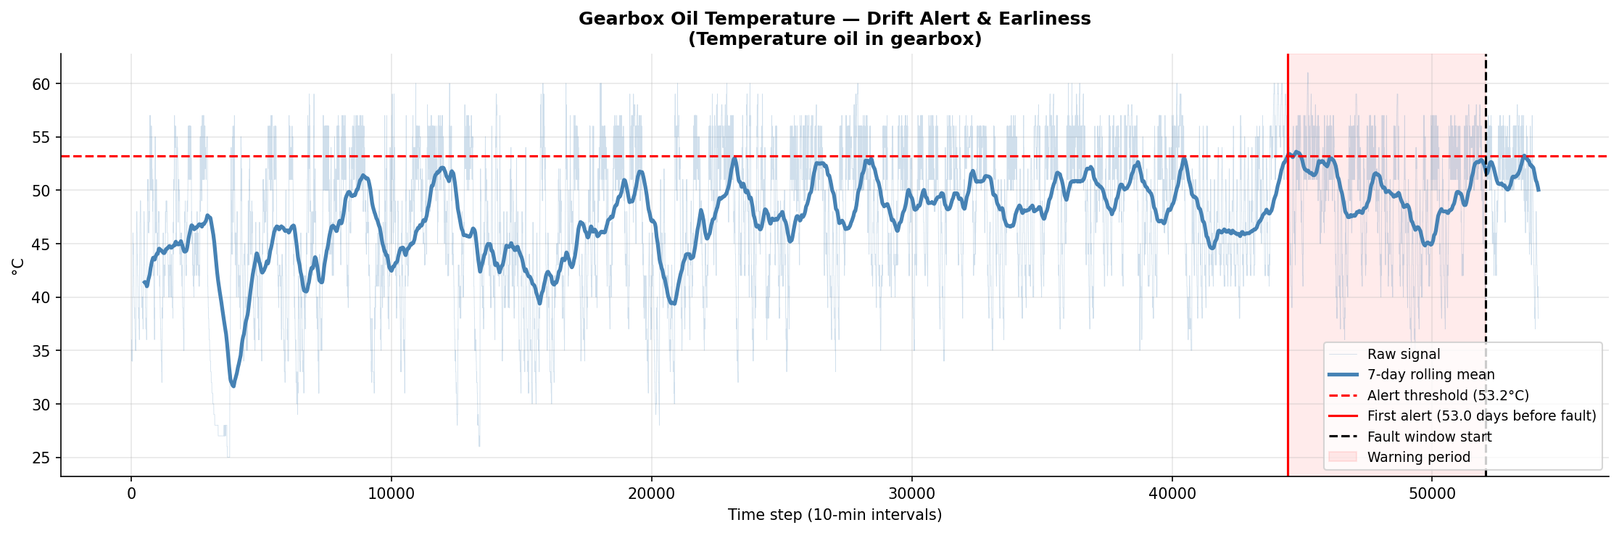
We set an alert threshold at 53.2°C — calculated from this turbine's own first 30 days of operation, specifically the baseline mean of 42.4°C plus 2.3 standard deviations. The red vertical line is when our system would have fired an alert. The dashed black line is when the fault actually occurred. Our method detected the developing gearbox fault 53 days before failure, nearly two months of advance warning for operators to plan, schedule, and act.
Notes:
"This is our early warning system in action. The dashed red horizontal line is our alert threshold — set at 53.2°C, calculated from the turbine's own first 30 days of normal operation. The solid red vertical line is the moment our system would have sent an alert. The dashed black line is when the gearbox actually failed. The shaded pink region is the warning period in between. Our method detected the developing fault 53 days before failure — giving operators nearly two months to schedule maintenance, order parts, and avoid an unplanned emergency shutdown that could cost tens of thousands of dollars in lost energy and repair costs."

Slide 6
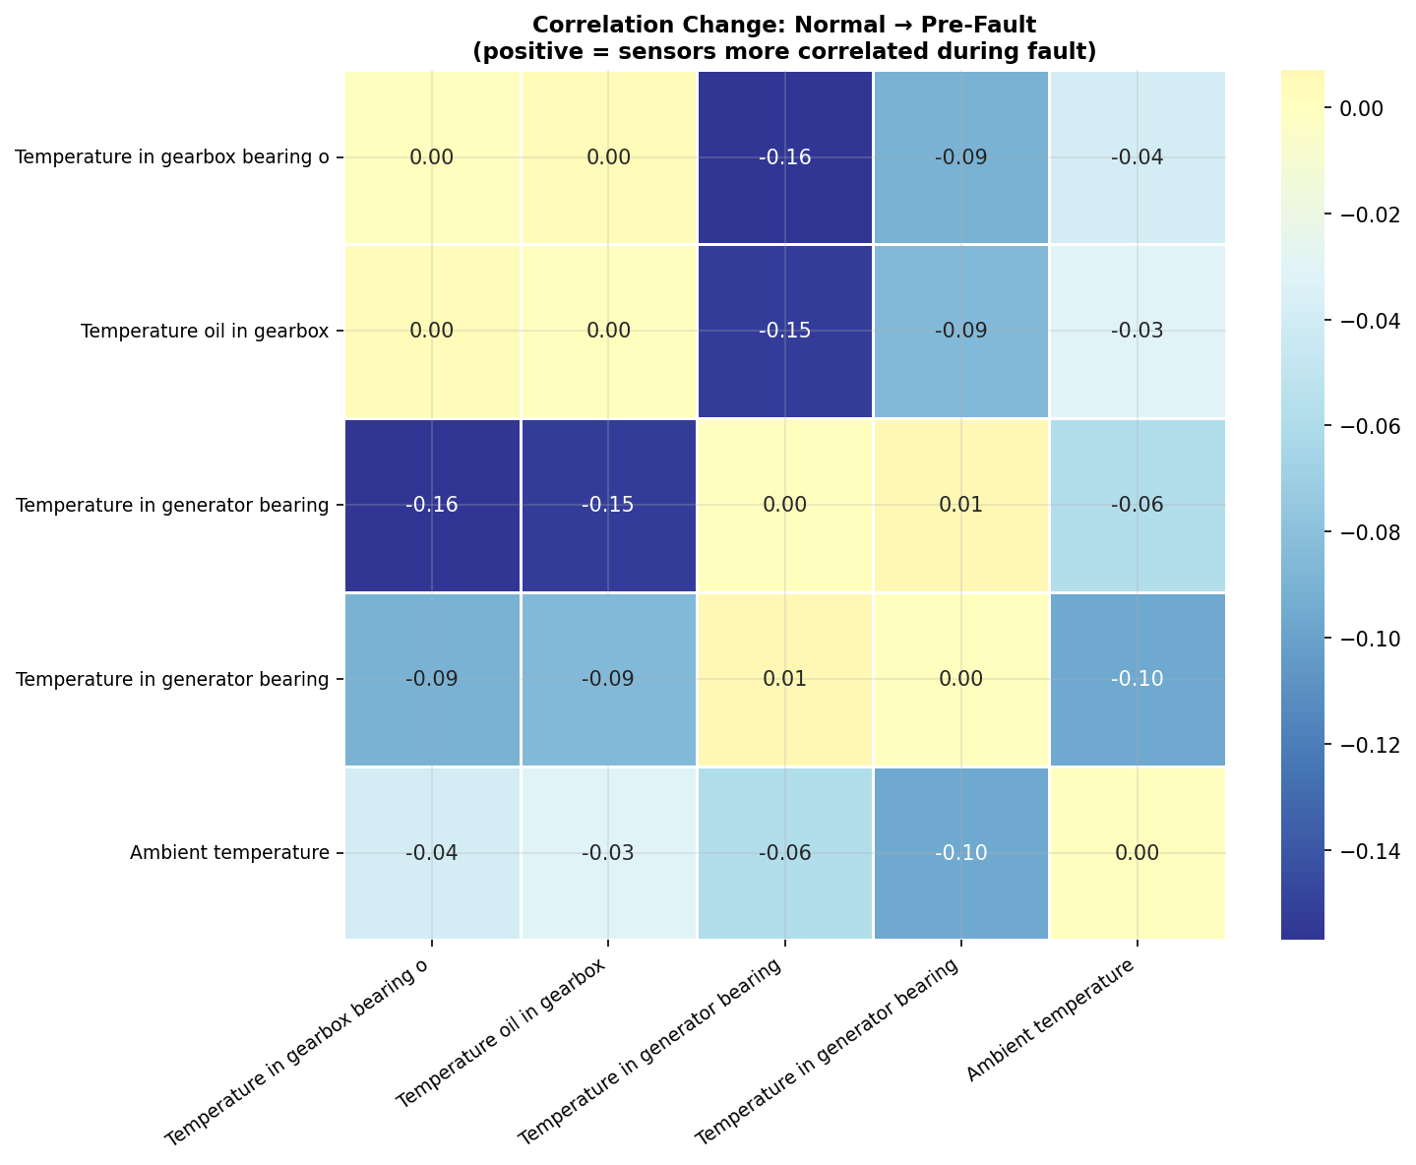
Notes:
"This is the most subtle but most insightful chart. It shows how the relationships between sensors change when going from a healthy turbine to a failing one. All the values are negative (shown in blue), meaning sensors become less correlated during a fault. The strongest change is between the gearbox sensors and the generator bearing sensors — dropping by 0.15 to 0.16. In plain terms: during normal operation these components move in sync, but as the gearbox deteriorates, it starts behaving independently from the rest of the drivetrain. This decoupling is itself a fault signature — and could be used as an additional alert trigger beyond just temperature thresholds."

Slide 7
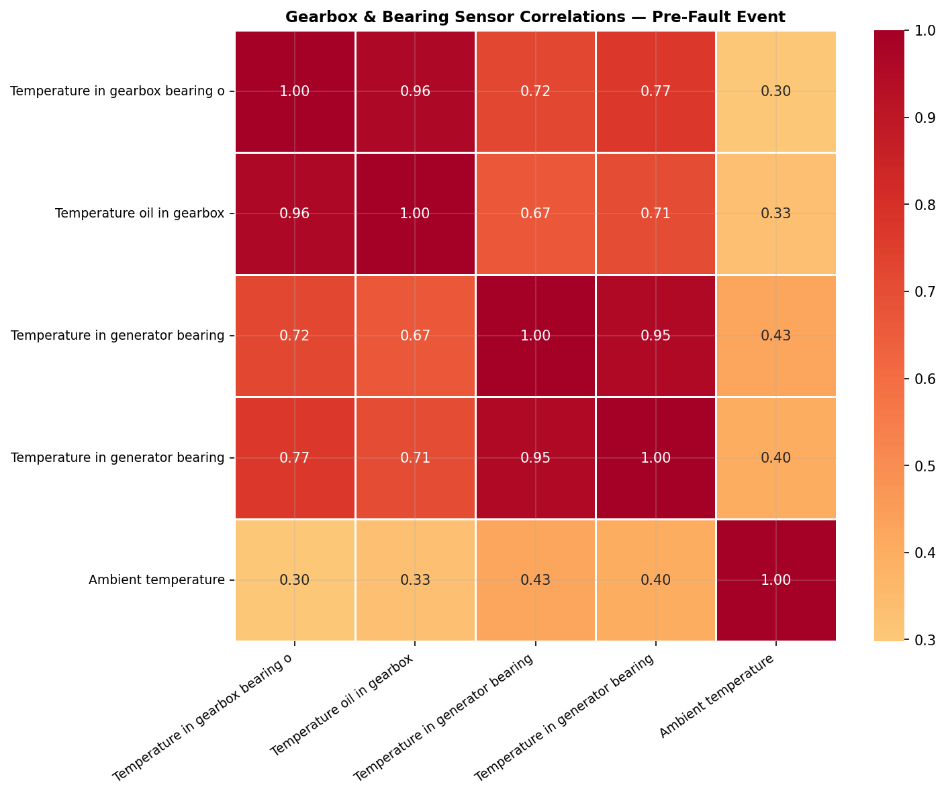
Notes:
"This chart shows how strongly different sensors move together. A score of 1.0 means two sensors are perfectly in sync; 0.0 means they're completely independent. The gearbox bearing and gearbox oil temperatures are 0.96 correlated — almost perfectly linked, which makes physical sense since the oil lubricates the bearing. More interestingly, the gearbox sensors also show 0.72 and 0.77 correlation with the generator bearings. This tells us that when the gearbox starts running hot, the heat propagates to the generator — meaning a single gearbox alert should also trigger inspection of the generator bearings."

Slide 8
How do normal vs. anomalous periods differ across turbines, and what thresholds trigger alerts?

Slide 9
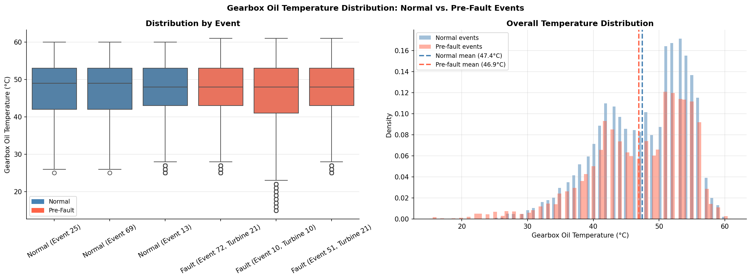
Before looking at thresholds, we needed to understand whether normal and pre-fault temperatures are even statistically distinguishable. The box plots on the left compare 3 normal events against all 3 gearbox fault events. The distributions overlap heavily — the medians are almost identical. The histogram on the right confirms this: normal events average 47.4°C, pre-fault events average 46.9°C — a difference of just half a degree. This is a critical finding: you cannot detect a gearbox fault by looking at average temperature alone. The fault signal lives in the trend over time, not the absolute value. This is exactly why the rolling mean approach is necessary.
Notes:
Temperature Distribution Comparison
"The left chart shows box plots — think of each box as representing where the middle 50% of temperature readings fall for that event. The line inside each box is the median. The dots below are extreme outlier readings, typically from turbine shutdowns. What's notable here is that the blue (normal) and red (pre-fault) boxes overlap heavily — their medians and spreads are very similar. This tells us that looking at raw temperature alone, it's hard to separate healthy from failing turbines using a simple cutoff.
The right chart confirms this — the overall temperature distributions of normal events (blue) and pre-fault events (red) are almost completely overlapping, with means only 2.5°C apart (47.4°C normal vs. 46.9°C pre-fault). This is a really important honest finding: the fault signal isn't in the average temperature level — it's in the trend over time. This is exactly why the 7-day rolling mean drift approach is necessary rather than just setting a fixed temperature alarm."

Slide 10
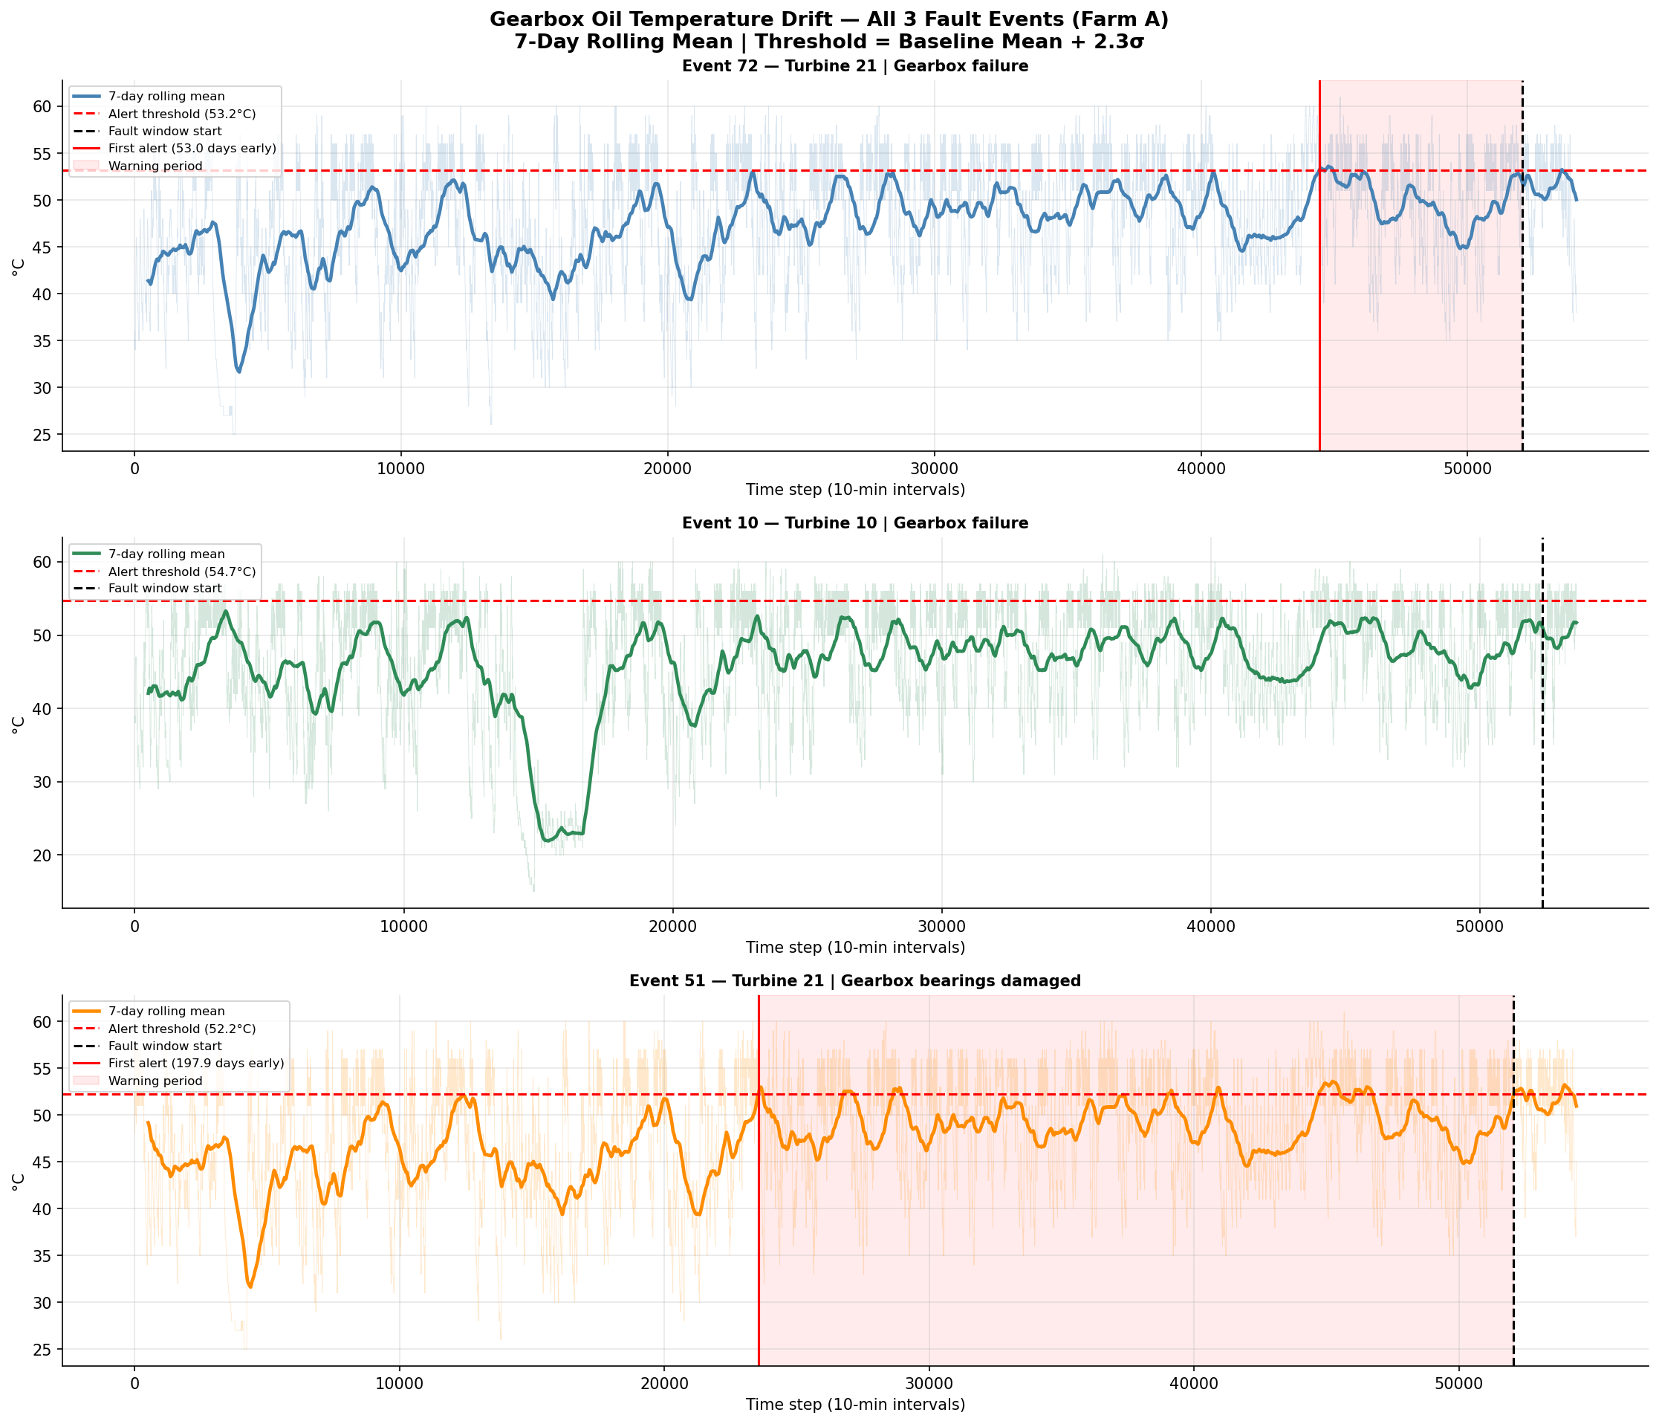
We then ran the same drift analysis across all 3 gearbox fault events in Farm A, each from a different turbine. The results were striking. Turbine 21 Event 72 — top panel — shows a clean 53-day warning with the rolling mean crossing the threshold shortly before failure, exactly what we want. Turbine 10 Event 10 — middle — never crosses its threshold at all, meaning gearbox oil temperature alone wasn't the dominant signal for this failure. Turbine 21 Event 51 — bottom — triggers 198 days early, which is too broad to be operationally useful on its own. Three turbines, three different behaviors. This proves that a single fixed threshold applied across the whole fleet would either miss faults or generate constant false alarms.
Notes:
CROSS TURBINE DRIFT COMPARISON "This chart stacks the same analysis across all three gearbox fault events recorded in Farm A, each from a different turbine. The colored line is the 7-day rolling average temperature, the dashed red horizontal line is each turbine's personalized alert threshold, and the dashed black vertical line marks when the fault was officially recorded.
Three things stand out. First, Turbine 21 (Event 72, top) shows a clean 53-day warning — the rolling mean crosses the threshold shortly before the fault, exactly what a good early warning system should do. Second, Turbine 10 (Event 10, middle) never crosses its threshold at all before the fault — the rolling mean stays below 54.7°C right up until failure. This tells us gearbox oil temperature alone isn't a universal signal for every turbine. Third, Turbine 21's second event (Event 51, bottom) triggers 198 days early, which is again too broad. Together these three panels make a crucial point: no single threshold works the same way across turbines, which is exactly why per-turbine baselines are essential for a reliable fleet-wide monitoring system."

Slide 11
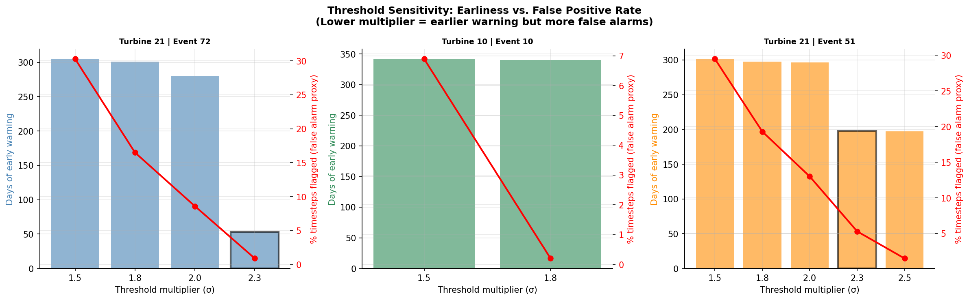
This chart makes that tradeoff quantitative. For each turbine we tested threshold multipliers from 1.5 to 3.0 standard deviations. The blue bars show days of early warning — higher is better. The red line shows the percentage of normal operating timesteps that would be incorrectly flagged as anomalies — lower is better. At 1.5 sigma, Turbine 21 gets 304 days of warning but 30% of all readings trigger false alarms — completely unworkable in practice. At 2.3 sigma, we get a clean 53 days of warning with near-zero false positives. Our recommendation is 2.3 sigma as the standard multiplier, applied to a per-turbine baseline computed from each turbine's first 30 days of operation.
Notes:
Threshold Sensitivity Analysis "This chart shows the tradeoff every engineer faces when designing an alarm system: set the threshold too low and you get lots of false alarms that waste maintenance resources; set it too high and you miss real faults until it's too late.
Each of the three panels represents one turbine. The blue bars show how many days of early warning you'd get at each threshold multiplier. The red line shows what percentage of normal operating timesteps would incorrectly trigger an alarm — the false positive rate.
For Turbine 21 Event 72 (left): at a multiplier of 1.5, you get 304 days of warning but 30% of all readings are flagged as anomalies — far too noisy to be useful. At 2.3, you get a clean 53 days of warning with near-zero false positives — a much better operational balance.
For Turbine 10 (middle): the threshold is never breached cleanly — even at 1.5 the false positive rate drops to near zero quickly, meaning this turbine's oil temperature simply didn't drift enough before failure to be detectable this way.
For Turbine 21 Event 51 (right): 2.3 gives around 198 days of warning with about 5% false positives — acceptable but still broad.
The key takeaway is that 2.3 standard deviations is the sweet spot across these turbines — it balances early detection with operational reliability, and our recommendation is to use this as the standard multiplier with per-turbine baselines."

Slide 12
How might explainable models reduce unnecessary maintenance while catching issues months ahead?

Slide 13
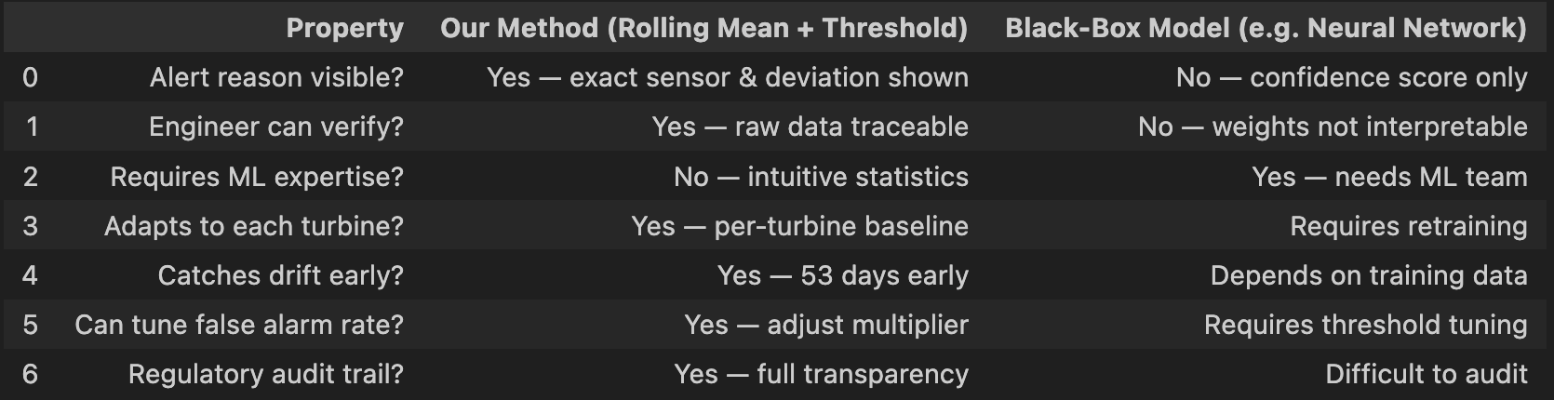
Before we talk about cost savings, it's worth addressing why explainability matters at all. Many advanced anomaly detection systems use neural networks or random forests — they might perform well, but when they fire an alert, all they tell an engineer is a confidence score. The engineer can't verify it, can't audit it, and may not trust it enough to act on it. Our method is the opposite. Every alert comes with the exact sensor, the exact deviation in degrees and standard deviations, the turbine's personal baseline, and a recommended action. An engineer can verify our finding in 30 seconds from raw data. No ML expertise required. Full audit trail. That's what makes a monitoring system actually deployable in the real world

Slide 14
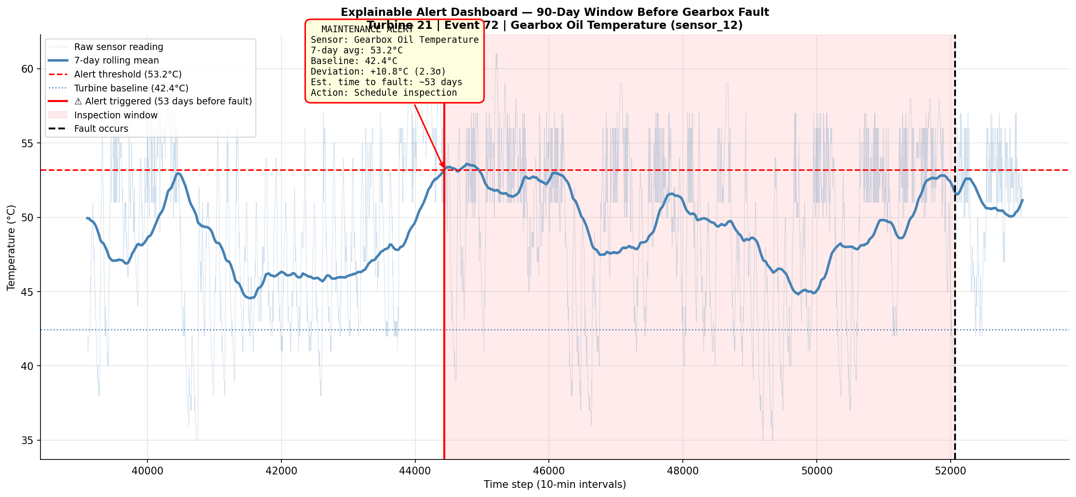
This is what that looks like in practice. This is the 90-day window before the gearbox failure. When our system fires — the red vertical line — the engineer sees this alert card: gearbox oil temperature is running at 53.2°C, 10.8°C above this turbine's baseline of 42.4°C, a 2.3 standard deviation deviation, with an estimated 53 days until fault. Recommended action: schedule inspection. That's the entire alert. Clear, traceable, and actionable.

Slide 15
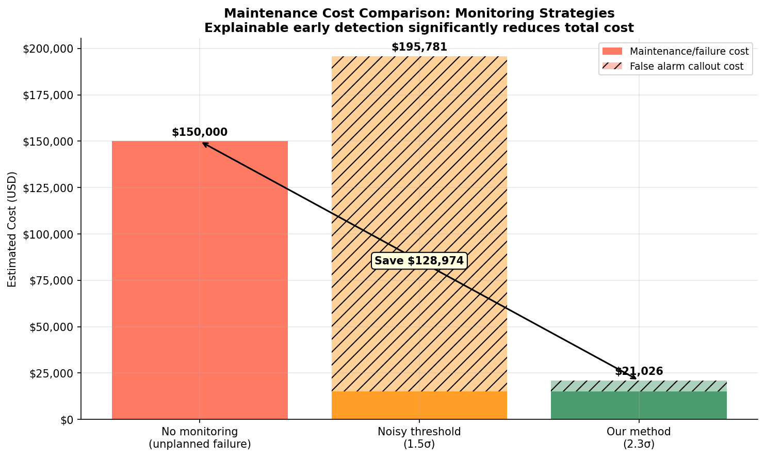
Now let's put a dollar value on this. We modeled three scenarios. No monitoring at all leads to an unplanned failure costing $150,000 — emergency repairs, crane hire, and lost energy revenue. A poorly tuned low threshold at 1.5 sigma generates 36 unnecessary callouts over the observation period, adding $180,781 in wasted dispatch costs on top of planned maintenance — totalling $195,781, which is actually worse than doing nothing. Our tuned 2.3 sigma method produces approximately 1 unnecessary callout, bringing total cost to just $21,026. That's a saving of $128,974 per turbine per fault event compared to unplanned failure, and $174,755 compared to a poorly calibrated alarm system.
Scaled across a 36-turbine wind farm, even if only half the turbines experience a gearbox event in a given year, that's over $2 million in potential annual savings — from a method built entirely on transparent, interpretable statistics.

